Slide 1
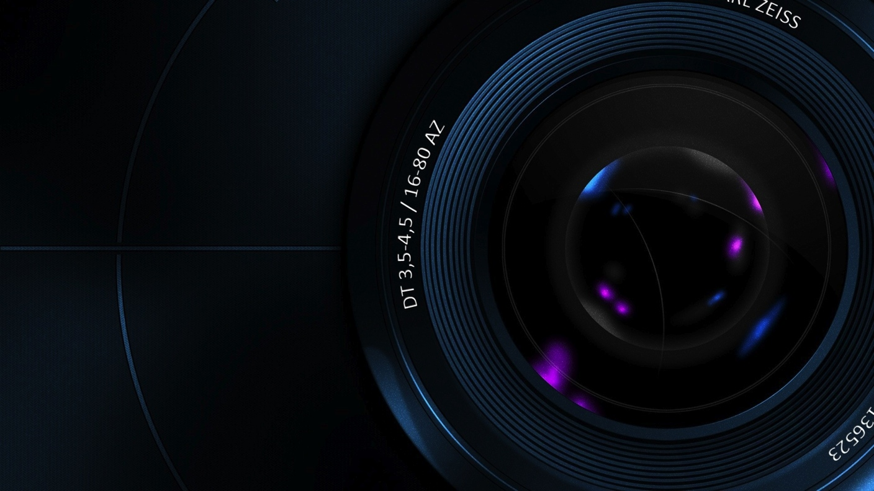
Camera Shots, Angles & Movements

Slide 2
Camera Shots

Slide 3
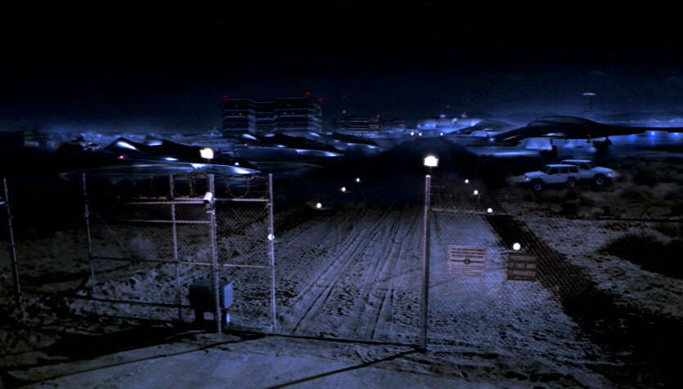
Extreme Long Shot – XLS:
The XLS is used to show a large area or landscape. It is the
most impersonal of camera shots since it is difficult to see
emotions on faces. The XLS is often called the establishing
shot as it is usually used to establish the setting of a scene to
orient the viewer to the coming surroundings.

Slide 4
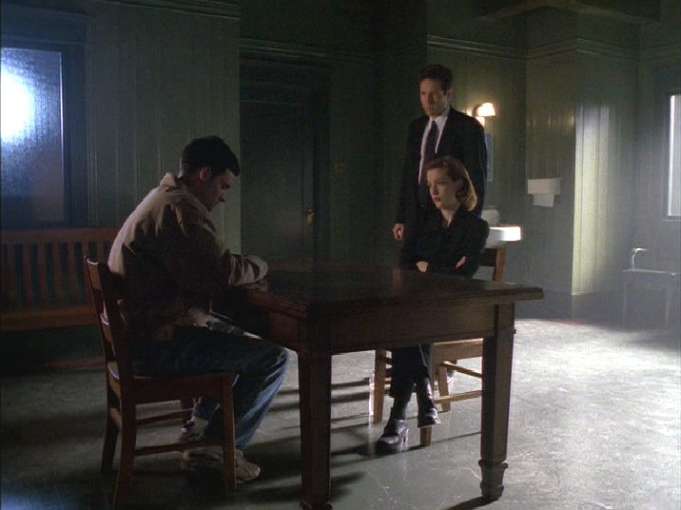
Long Shot – LS:
The LS shows the entire subject from head to toes. It often
includes a bit of background, so allows the viewer to see the
relationship between the subject & surroundings. Still an
impersonal shot, as faces are difficult to see.

Slide 5
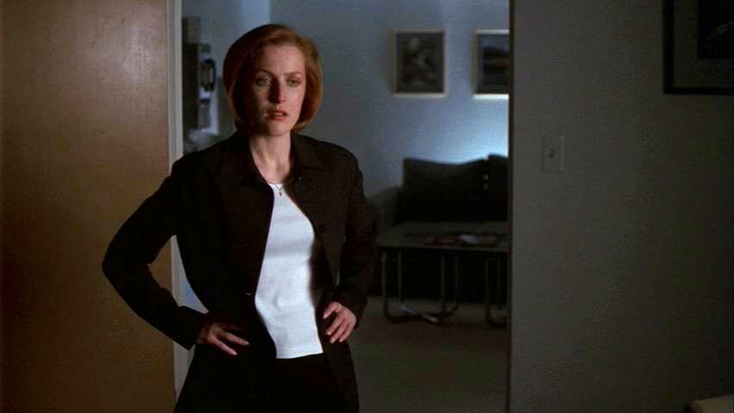
Medium Shot – MS:
The MS shows the subject from the waist up. It is a very
“comfortable” shot since it most like having a normal
conversation with someone.

Slide 6
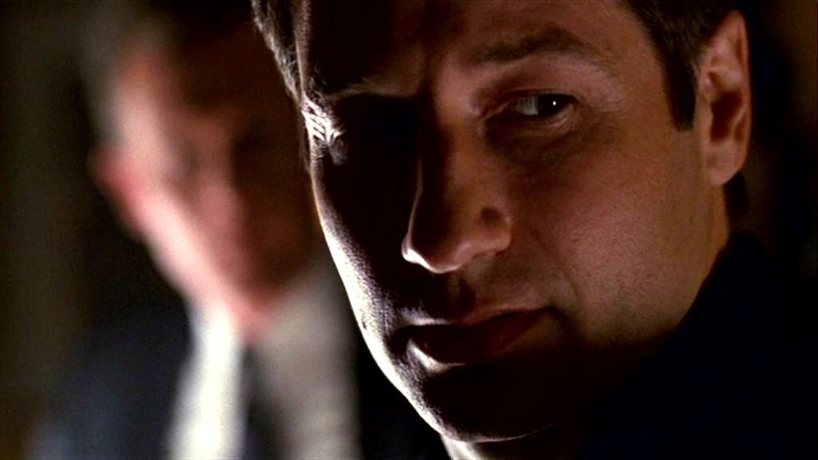
Close Up – CU
The CU shows the head and neck of the subject. A variation
of this is the Medium Close Up (MCU) which shows the head
and shoulders. The CU is emotionally involving since it
seems like the viewer is face to face with the subject. The
MCU is used heavily in television news, and allows the
viewer to see the subject’s emotions.

Slide 7
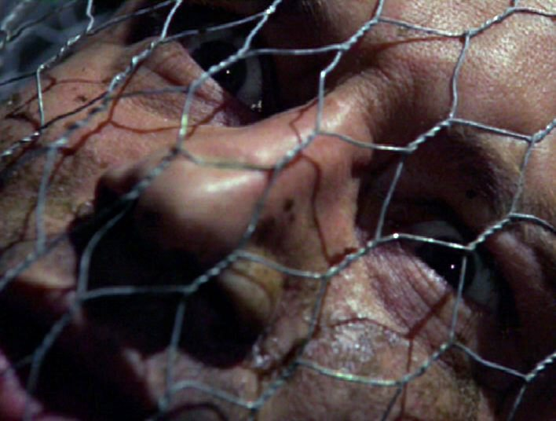
Extreme Close Up – XCU
The XCU fills the entire frame. It is great for showing
emotion and detail making the shot deeply emotional and
dramatic. The XCU can be disturbing to the viewer, as it
feels like the viewer is too close to the subject.

Slide 8
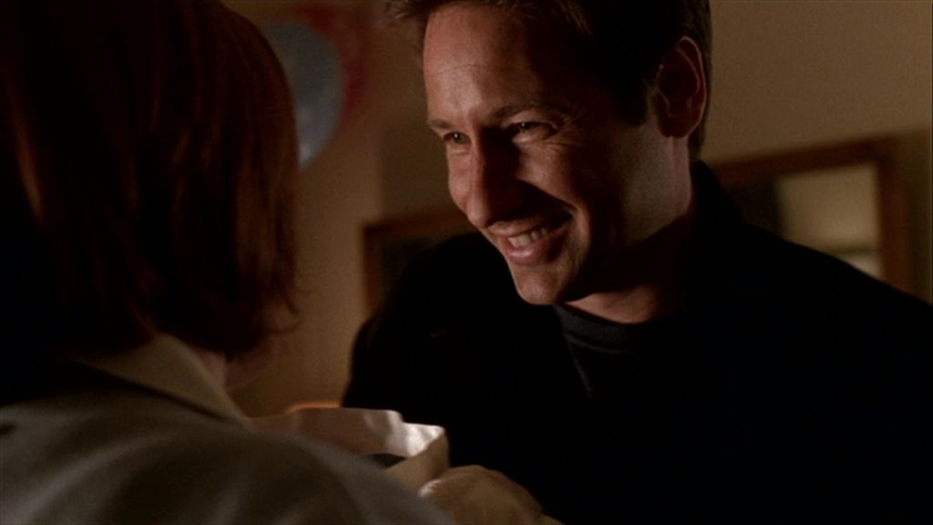
The Reaction Shot – RS:
The Reaction Shot shows the effect of one subject’s words
or actions on another subject. It is not uncommon for the
viewer to be more interested in the person listening than
in the person speaking.

Slide 9
Camera Angles

Slide 10
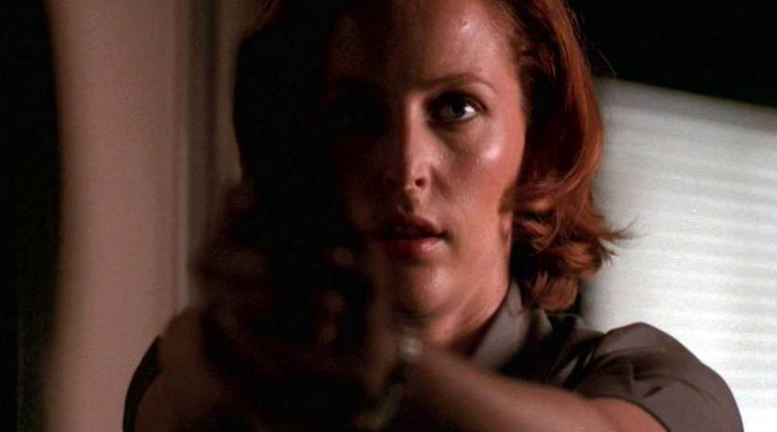
Eye Level
Shows the subject at the same level as the viewer.
A normal type of angle which is great for
conversations.

Slide 11
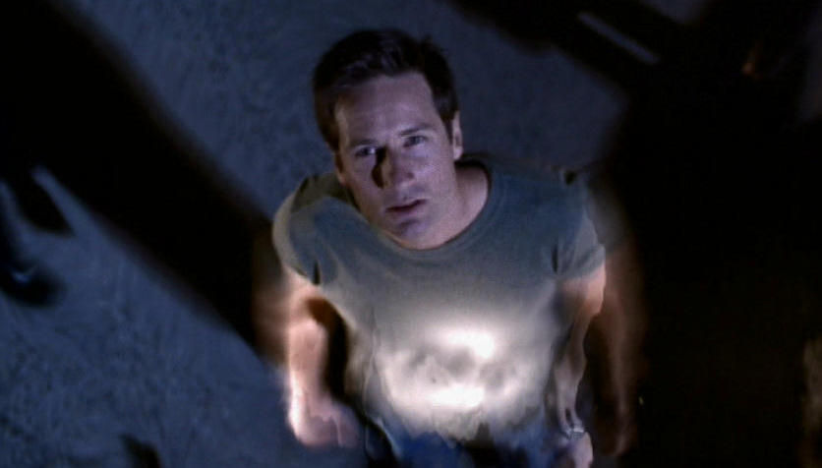
High Angle
The high angle is shot from above the subject, looking
down. This angle often has the effect of making the
subject appear small, weak, powerless and inferior.
An extreme high angle is called a bird’s eye view and
almost looks directly down on the subject.

Slide 12
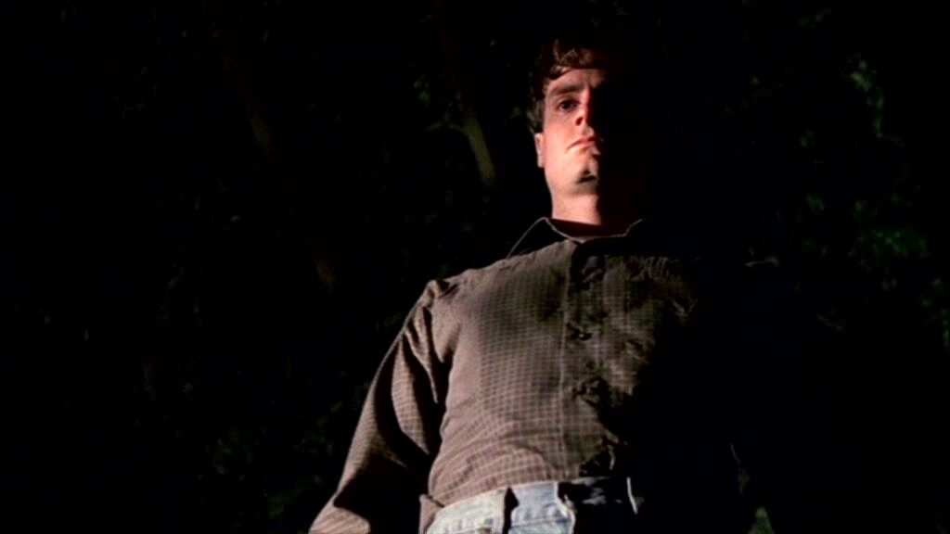
Low Angle
Shot from below the subject, a low angle makes it appear big,
powerful & strong. The subject often takes on a sense
of power and authority and this angle can lead to a
sense of fear or awe. An extreme low angle shot is called
a worm’s eye view. To achieve it, the camera is often
placed below ground level or the subject is elevated above
the camera.

Slide 13
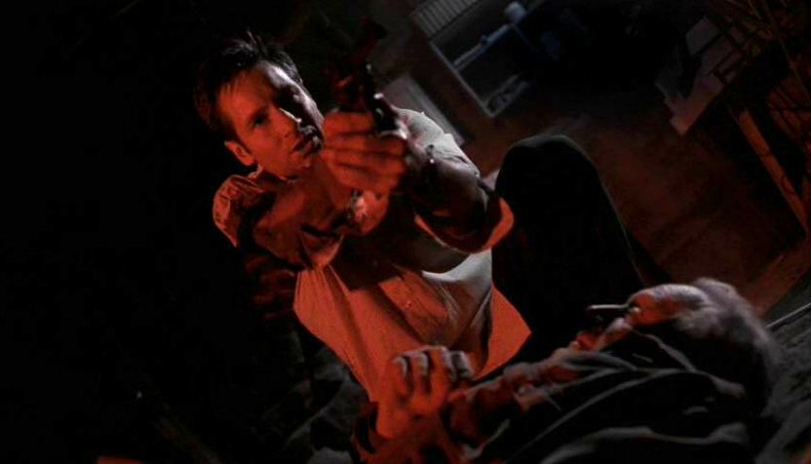
Canted or Oblique Angle
Shows the subject or horizon tilted on an angle. The
Canted Angle distorts the image and disorients the
viewer. This angle can create “motion” where there is none.

Slide 14
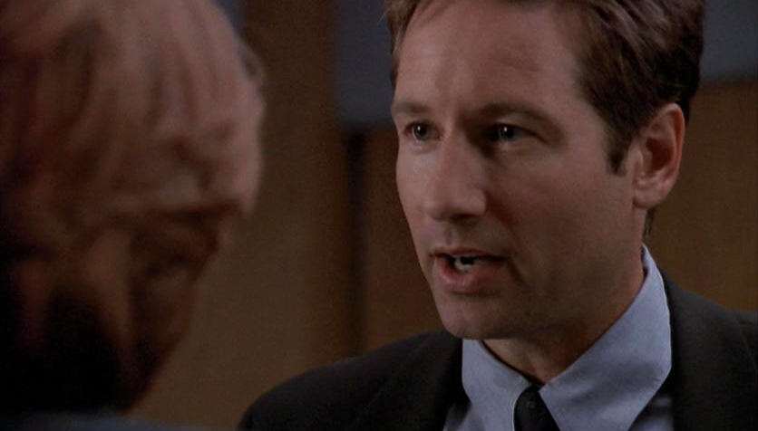
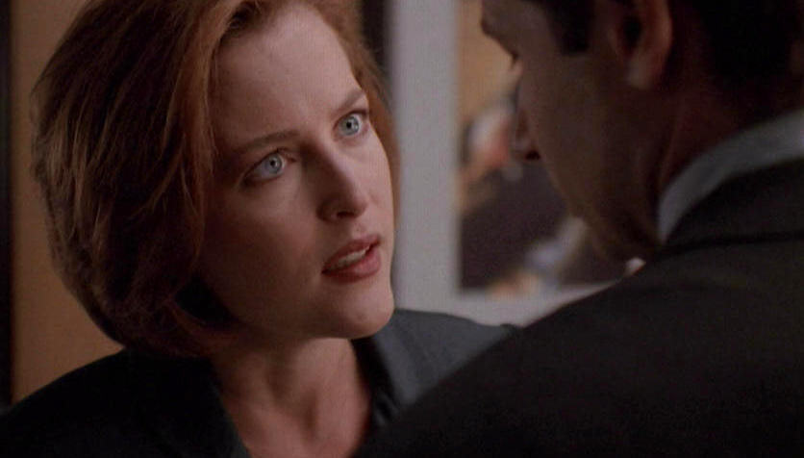
The Reverse Angle
Shows the subject from the opposite point of view. Most
frequently used when two characters are having a
conversation. The reverse angle can be 180 degrees around,
but is usually 150 degrees, resulting in two or more matched
over the shoulder shots.

Slide 15
Camera Movements

Slide 16
THE PAN:
A horizontal twist of the camera on its mount,
either left to right, or right to left.
-A pan that goes from left to right seems natural
and gives a sense of order or a sense of the way
things should be.
-A pan right to left will give a sense of disorder,
chaos or impending danger.
THE TILT:
A vertical movement of the camera up or down.
-The tilt up implies growing, expanding, reaching up, and inspires
in the viewers a sense of awe or greatness.
-The tilt down implies descending, looking down upon, or becoming smaller.
The resulting shot gives a sense of being depressed or saddened.

Slide 17
THE ZOOM:
The effect created by changing the focal
length of the lens during a shot.
-The edges of the image simply disappear at all
sides. The effect is of sudden magnification.
-Instead of feeling as though we are entering a
scene, we feel as though a small portion of a
scene has been thrust toward us.

Slide 18
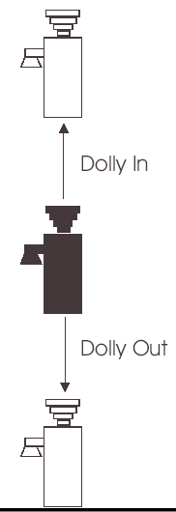
THE DOLLY:
A movement of the entire camera mount
either toward or away from the subject.
-Gives the viewer a sense of entering
into or withdrawing from a set. It is as if
the viewer is on the set walking forwards
or backwards.
-The dolly-in is emotionally involving,
whereas the dolly-out is emotionally
detaching.

Slide 19
THE TRUCK:
A movement of the entire camera
mount in a line which is not toward
or away from the subject is called
trucking.
-The truck shot gives a viewer the sense
of moving along with subject.
-A truck left to right gives the sense of
natural order, while a truck right to left
gives the sense of disorder.
THE ARC:
A truck shot which follows a curved
path is known as an arc shot
-The arc shot combines the meaning of
the truck shot and the dolly shot. As a
result the arc can have a very strong
emotional appeal.

