Slide 1
Welcome to English 2PI!
Here’s the scoop…

Slide 2
What to expect in English 2PI
The Ministry of Ontario Guideline expects us to focus on the following skills:
Listening and Speaking
Reading
Writing
Media Literacy

Slide 3
Essential Course Components:
Listen to understand & respond appropriately
Speak to communicate to a variety of audiences
Read and understand a variety of texts
Recognize a variety of writing forms
Develop and organize content for writing

Slide 4
Essential Course Components, cont’d.
Use knowledge of form and style to draft and revise writing
Apply knowledge of language conventions to writing
Understand a variety of media texts and forms, conventions and techniques
Create a variety of media texts
Reflect on strengths, areas for improvement and helpful strategies

Slide 5
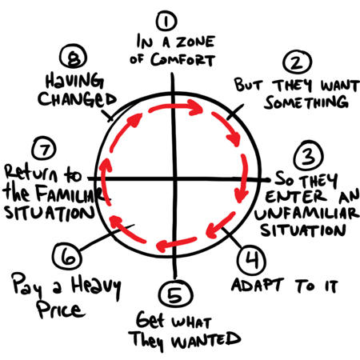
Unit #1: The Hero's Journey
Examine the concept of the hero's journey
Identify the stages of the hero's journey
Watch a movie and apply the hero's journey to it
Examine the hero's journey in children's stories

Slide 6
Unit #2: Accuracy in Writing
Mini-lessons to review:
Parts of speech
Parts of a sentence
Punctuation
Sentence errors
Commonly misspelled words

Slide 7
Unit #3: Novel Speak
Read for meaning
Reading quizzes
Paragraph writing
Research topics
PowerPoint presentation

Slide 8
Unit #4: Memoirs and Storytelling
Examine the form of the memoir
Read several memoirs
Interview someone in your life
Create a memoir media project

Slide 9
Unit #5: Formal Essay Writing and Film Study
Study film techniques
Film terms quiz
Formal essay

Slide 10
Unit #6: Literature Circles
Reading quizzes
Group discussions
Personal responses
Creative choices project

Slide 11
Unit #7: Poetry
Read a variety of poems
Poetry quiz
Poem assignment

Slide 12
Unit 8: Summative (30%)
Project and Exam: demonstrate student’s understanding of the course content
Stop-Motion Project with “Fantastic Mr. Fox”

Slide 13
Procedures: Late & Missing Assignments
All essential learning must be demonstrated in order to earn a credit. Missed assessments jeopardize a student’s ability to demonstrate this learning.
Skills such as time management and planning will be reflected in the learning skills area of the report card.

Slide 14
Attendance:
Regular attendance is necessary for success
All students are expected to be on time
Completing missed work is the responsibility of the student

Slide 15
Cheating and Plagiarism:
If a student is suspected of cheating or plagiarizing, the student is still required to demonstrate the essential skill(s) for that particular assignment.
The student will be required to redo all or part of the original assignment, or to complete an alternate assignment or assessment as determined by the teacher.
Failure to do so will result in an “incomplete” for the essential skill(s) particular to that assignment or assessment and will jeopardize the credit.

Slide 16
Final Thoughts…
Do your best!
Complete all assignments
Attend class
Bring your positive with you
Use class time effectively
Take responsibility for your learning!
Be awesome!!

